Slide 1
Rotor Hub And Pitch System
Group Members :
Dhruvin Kakdiya
Adharsh Pappinisseri Veedu
Muthu Thirunavukarasu
Syed Mohammed Sikandar
Week number : 05
Date: 28/10/2025
Supervisor: Prof. Peter Quell
Syed Mohammed Sikandar

Slide 2
List of contents
Flange Connection
Pitch Break & Providers
Design & Calculation of Blade bearing
Syed Mohammed Sikandar

Slide 3
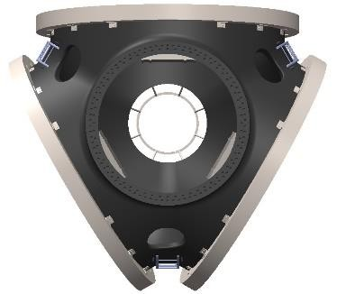
Integral Forged Bolted Flange Connection
The rotor hub and main shaft each have integral flanges machined into the forging.
These flanges are bolted together with a circular pattern of high-strength preloaded bolts.
This is the industry standard for large turbines (3–10 MW range).
One-piece forgings → no welds, excellent fatigue strength.
Preloaded bolts (M42–M64) to ensure no slip under cyclic torque.
High-precision machining to ensure perfect alignment of hub and shaft.
Early used in Siemens SWT-5.0-126, GE Haliade 5 MW, Vestas V164 (early prototypes).
Reference image, optimus ocean
Syed Mohammed Sikandar

Slide 4
Advantages:
Extremely robust and reliable.
Fully serviceable (bolted connection allows disassembly).
No weld fatigue risk.
Challenges:
Large-diameter forging (~2–3 m).
Expensive machining and alignment processes.
Syed Mohammed Sikandar

Slide 5
Brake Torque Assumptions
Based on the Shakti’s report and our data we have concluded the required maximum brake torque as,
MB = Brake torque/ ibearing * igearbox
= 543/ 13.81 * 221
Following the approach used in the Optimus Shakti , the design brake torque was set equal to the total blade-side torque (543 kN·m), ensuring the brake can fully hold the blade under maximum aerodynamic and frictional loading.
MB = 177.9 Nm
Syed Mohammed Sikandar

Slide 6



List of Pitch Break Providers
Syed Mohammed Sikandar

Slide 7
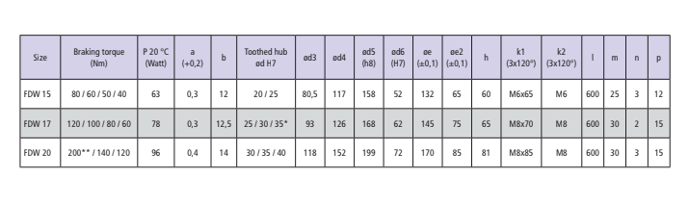
Syed Mohammed Sikandar

Slide 8
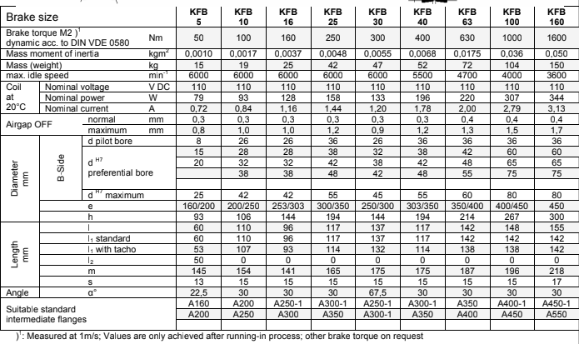

Syed Mohammed Sikandar

Slide 9
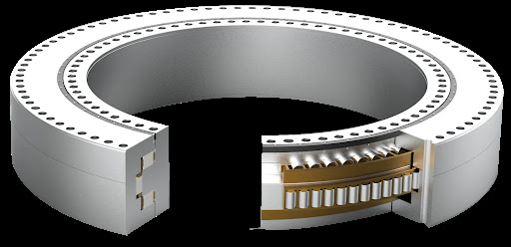
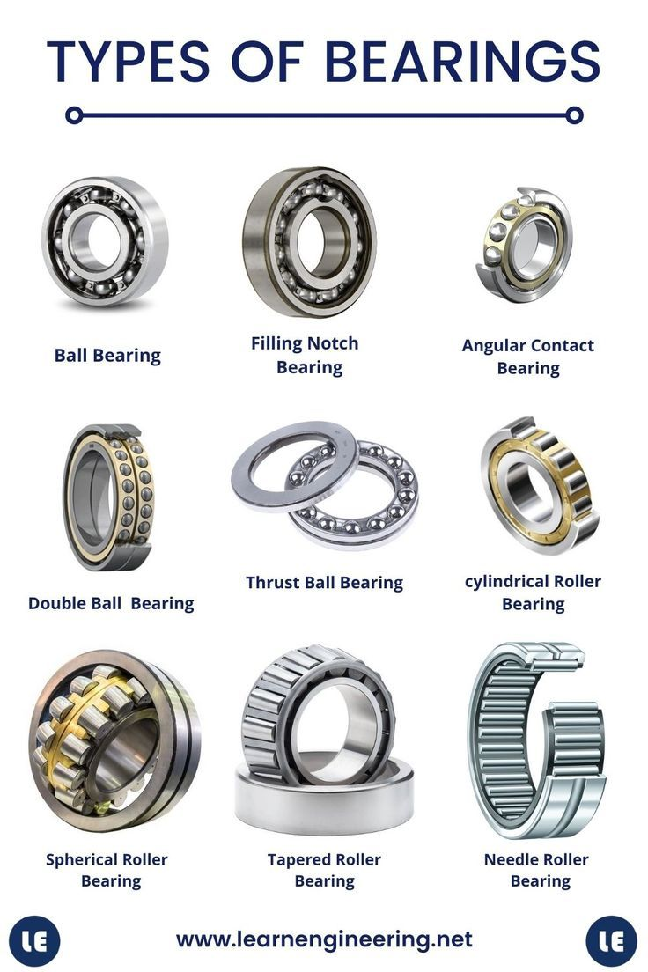
Design & Calculation of Blade Bearing
Blade bearings connect to the rotor blade and the rotor hub of a wind turbine by means of bolted connections.
It is essential to enable the rotor blades to rotate around their longitudinal axis .
This rotational capability is essential for adjusting the blade's pitch angle, which optimizes energy capture and protects the turbine under various wind conditions.
Four-point contact ball bearings
Three-row roller bearings
Three-row ball and roller bearings
Two-row angular contact bearings
Types of Bearings
(7)
(5)
Syed Mohammed Sikandar

Slide 10
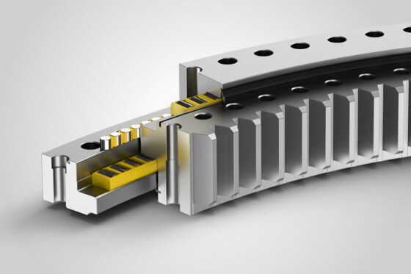
Reasons for selecting Triple row roller bearing
It have high capacity of load bearing because of high contact area in comparison to 4-point ball bearing
Triple row roller bearing has 2 rows for axial roller elements (axial loads) and 1 row for radial roller bearing(radial loads).
Outer Ring Rotating
The blade is attached to the outer ring of the pitch bearing, while the inner ring is fixed to the hub .
This design offers several advantages,
Enabling a smaller and lighter hub,
Simplifying the connection of the lubrication system to the blade bearing,
Creating additional space within the hub.
(3))
(4)
Syed Mohammed Sikandar

Slide 11
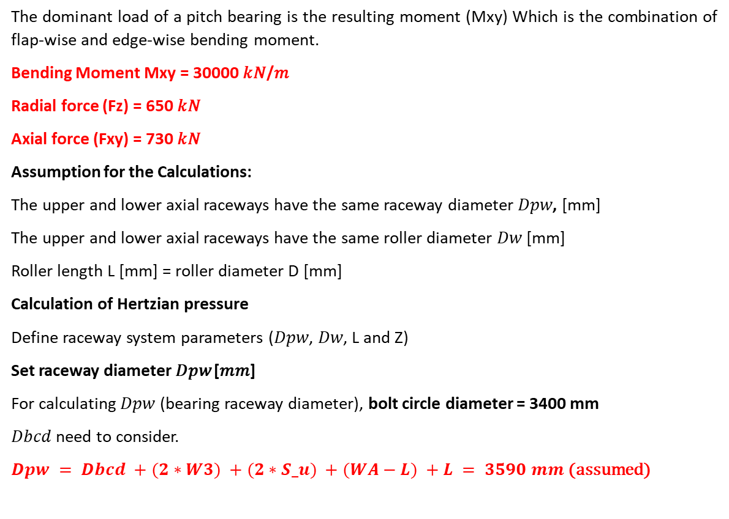
Dimensioning of the Three row roller bearing
Load | Shakti | Syria
Fx | 1034.29 kN | ≃ 840 kN
Fy | 779.43 kN | ≃ 630 kN
Fxy | 900 kN | ≃ 730 kN
Fz | 800 kN | ≃ 650 kN
Mx | 23056.8 kNm | ≃ 17000 kNm
My | 49553.14 kNm | ≃ 36000 kNm
Mxy | 40000 kNm | ≃ 30000 kNm
Mz | 500 kNm | ≃ 370 kNm
The dominant load of a pitch bearing is the resulting moment (Mxy) Which is the combination of flap-wise and edge-wise bending moment.
Bending Moment Mxy = 30000 𝑘𝑁/𝑚
Radial force (Fz) = 650 𝑘𝑁
Axial force (Fxy) = 730 𝑘𝑁
Assumption for the Calculations:
The upper and lower axial raceways have the same raceway diameter 𝐷𝑝𝑤, [mm]
The upper and lower axial raceways have the same roller diameter 𝐷𝑤 [mm]
Roller length L [mm] = roller diameter D [mm]
Calculation of Hertzian pressure
Define raceway system parameters (𝐷𝑝𝑤, 𝐷𝑤, L and Z)
Set raceway diameter 𝐷𝑝𝑤 [𝑚𝑚]
For calculating 𝐷𝑝𝑤 (bearing raceway diameter), bolt circle diameter = 3400 mm
𝐷𝑏𝑐𝑑 need to consider.
$Dpw = Dbcd +(2∗W3) +(2∗S_u) +(WA−L) +L = 3590 mm$ (assumed)
Syed Mohammed Sikandar

Slide 12
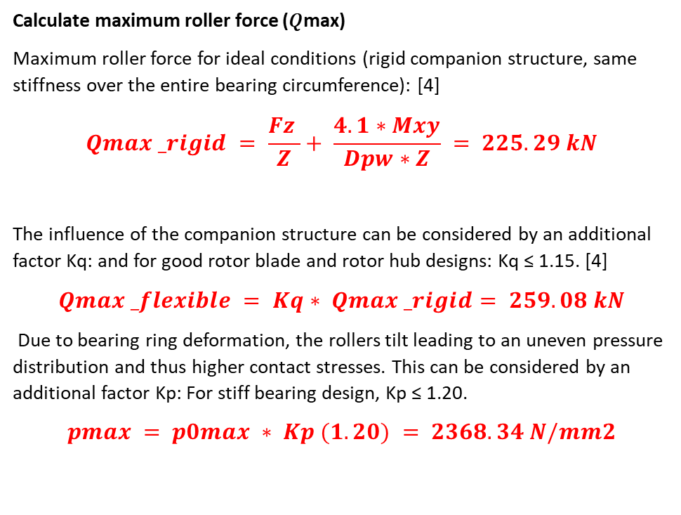
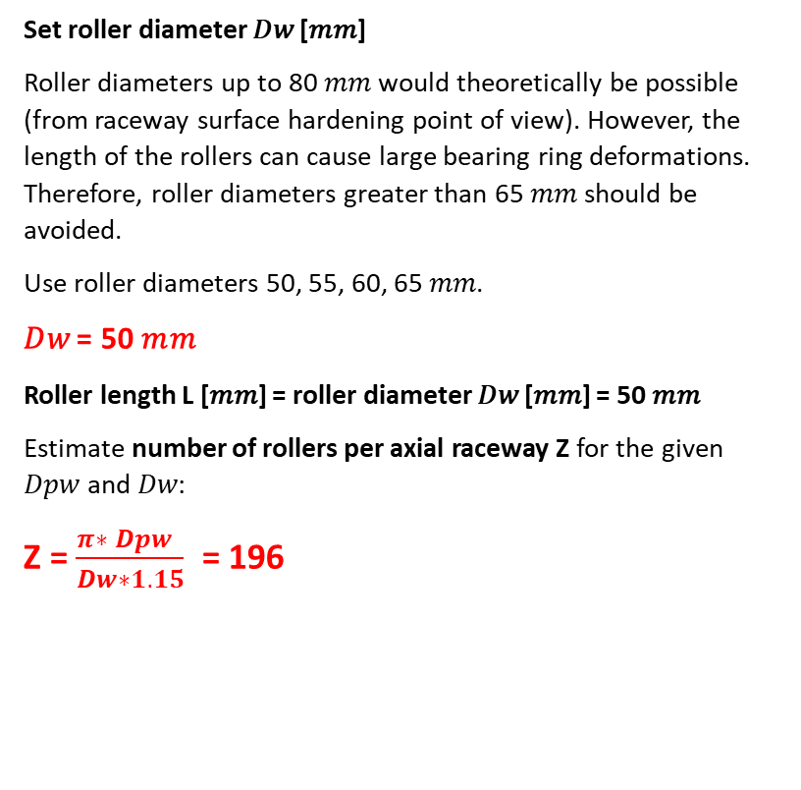
Set roller diameter 𝐷𝑤 [𝑚𝑚]
Roller diameters up to 80 𝑚𝑚 would theoretically be possible (from raceway surface hardening point of view). However, the length of the rollers can cause large bearing ring deformations. Therefore, roller diameters greater than 65 𝑚𝑚 should be avoided.
Use roller diameters 50, 55, 60, 65 𝑚𝑚.
𝐷𝑤 = 50 𝑚𝑚
Roller length L [𝑚𝑚] = roller diameter 𝐷𝑤 [𝑚𝑚] = 50 𝑚𝑚
Estimate number of rollers per axial raceway Z for the given 𝐷𝑝𝑤 and 𝐷𝑤:
Z = $\frac{π∗ Dpw }{Dw∗1.15}$ = 196
Calculate maximum roller force (𝑄max)
Maximum roller force for ideal conditions (rigid companion structure, same stiffness over the entire bearing circumference): [4]
$$Qmax _rigid = \frac{Fz }{Z}+ \frac{4.1∗Mxy}{Dpw∗Z} = 225.29 kN$$
The influence of the companion structure can be considered by an additional factor Kq: and for good rotor blade and rotor hub designs: Kq ≤ 1.15. [4]
$$Qmax _flexible = Kq∗ Qmax _rigid= 259.08 kN$$
Due to bearing ring deformation, the rollers tilt leading to an uneven pressure distribution and thus higher contact stresses. This can be considered by an additional factor Kp: For stiff bearing design, Kp ≤ 1.20.
$$pmax = p0max ∗ Kp (1.20) = 2368.34 N/mm2$$
Syed Mohammed Sikandar

Slide 13
Bibliography
https://www.precima.de/sites/default/files/media/brake_solutions_for_pitch-_and_yaw-drives_catalog.pdf [25.10.26]
Dellner-Bubenzer-KFB.pdf [25.10.26]
https://nawindpower.com/liebherr-optimizes-3-row-blade-bearings-for-wind-turbines (27.10.2025)
https://www.xzwdslewing.com/xzwd-slewing-bearings-for-wind-turbine-pitch-and-yaw-positions-product/ (27.10.2025)
https://plohicams9auser.z14.web.core.windows.net/types-of-bearings-chart.html (27.10.2025)
http://xql-slewingbearing.com/3-4-wind-turbine-pitch-bearings.html (27.10.2025)
Syed Mohammed Sikandar

